Slide 1
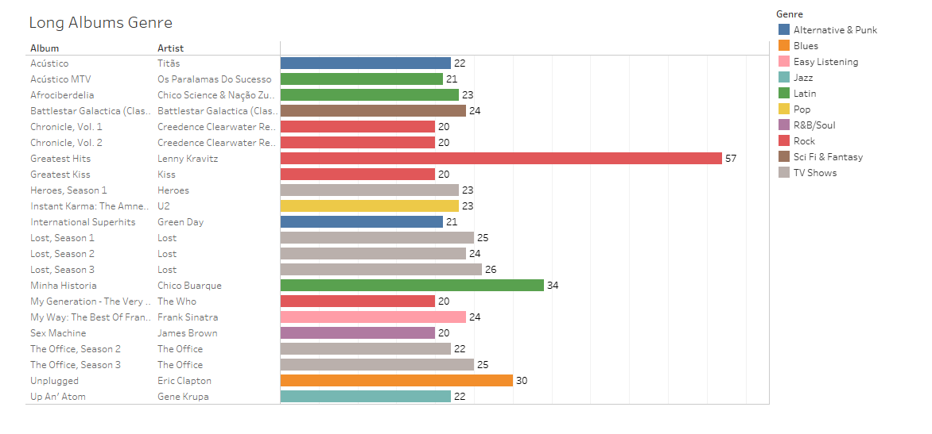
What are long albums genre?
Although longest album genre is Rock (57 Songs) but among long albums (Albums with 20 songs or more), TV Shows have the longest albums (6 Albums) and (145 Songs)

Slide 2
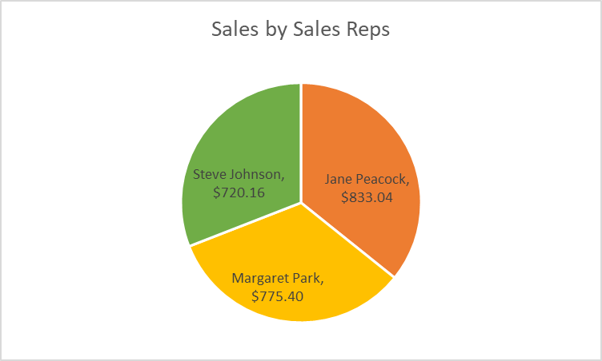
Who the sales support agent with the most sales?
Jane Peacock Comes first with 833.04$ Sales

Slide 3
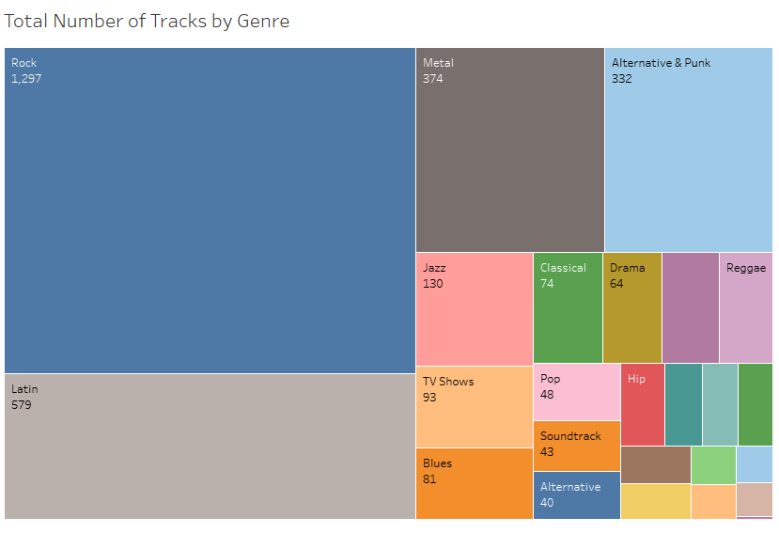
What is the genre with most tracks?
Rock is the most genre with most tracks (1297 Tracks) and Latin genre comes second With (579 Tracks)

Slide 4
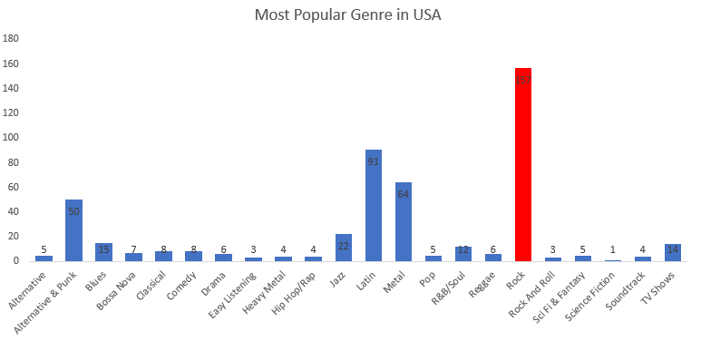
What is the most popular genre among USA customers?
Rock is the most popular genre in USA among customres

